Slide 1








F. Box and Whisker Diagram
·姚苏倪 演讲&ppt ·张乐桐 演讲&ppt ·陈弈佳 gdc演示 ·忻子婧 ppt

Slide 2

PART
1
Review to quartile
& IQR

Slide 3
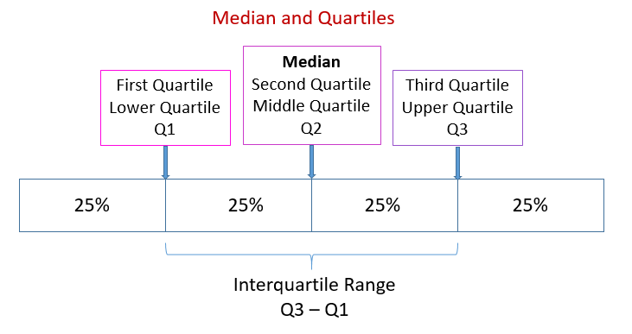
Introduction to Quartiles
What's quartile?
Quartile divides the number of data points into four parts, or quarters, of more-or-less equal size.

Slide 4
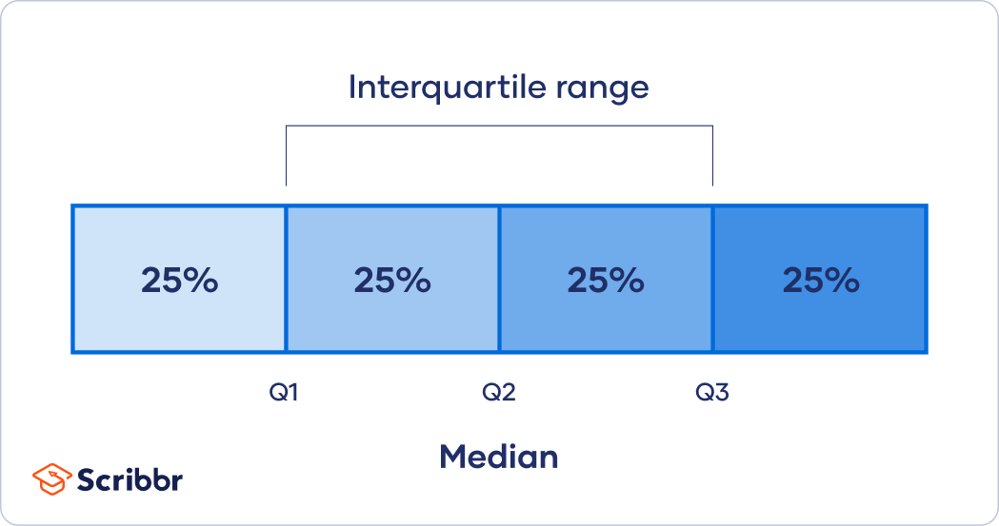
Introduction to IQR
What's interquartile range(IQR)?
The range of the middle half of the data. Often used to find outliers in data. (四分间距)

Slide 5
PART
2
Box and whisker diagram

Slide 6




A box and whisker diagram is a visual display of a data set that shows:
the minimum value (min)
the lower quartile (Q1)
the median (Q2)
the upper quartile (Q3)
the maximum value (max)

Slide 7
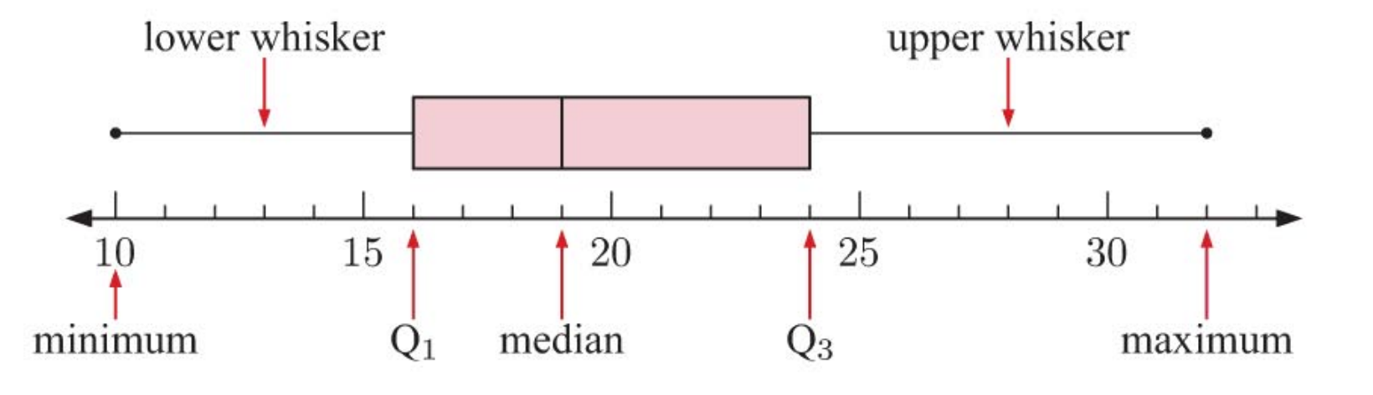

Slide 8
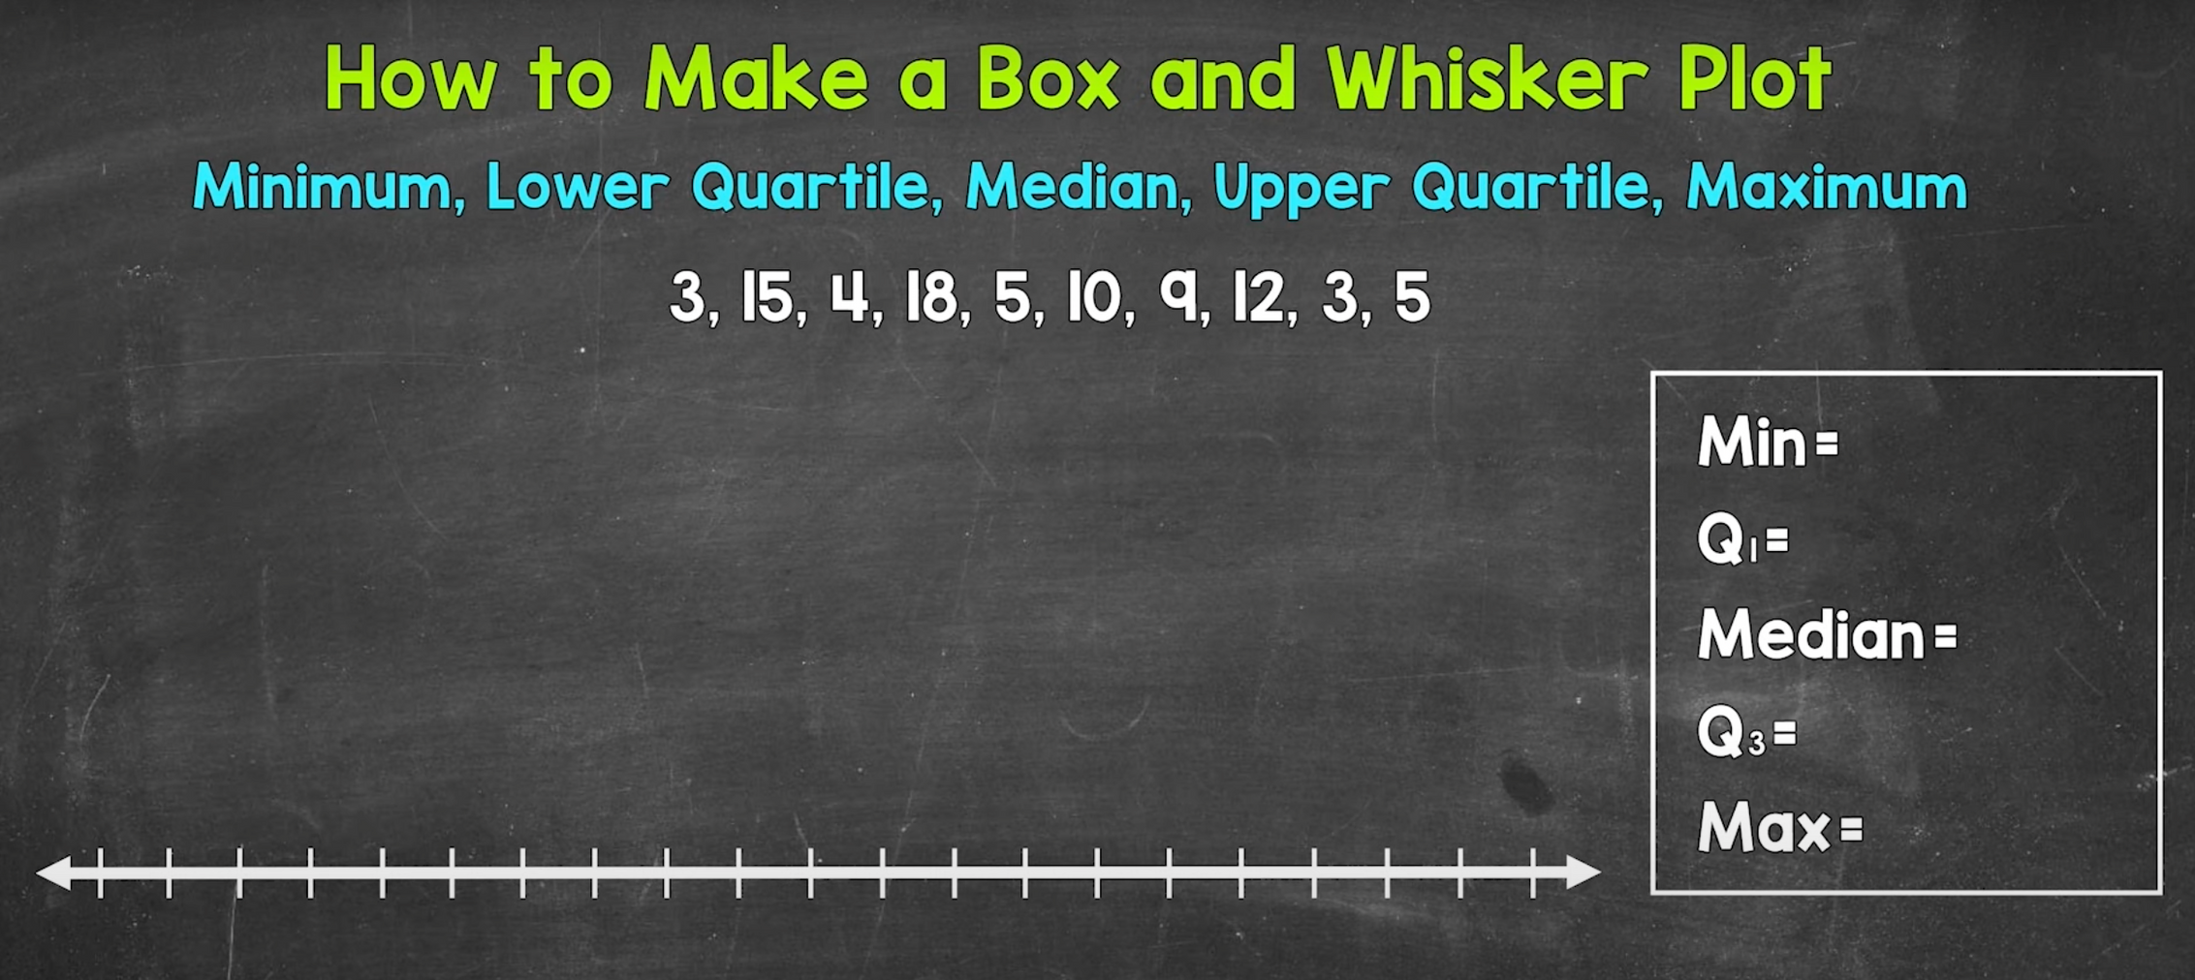

Slide 9
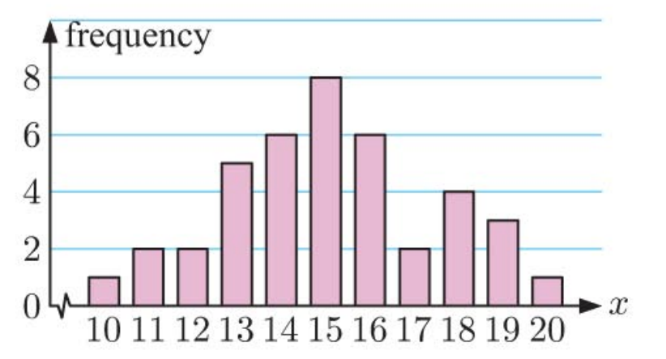
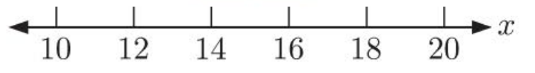
EX 1
Symmetric distribution

Slide 10
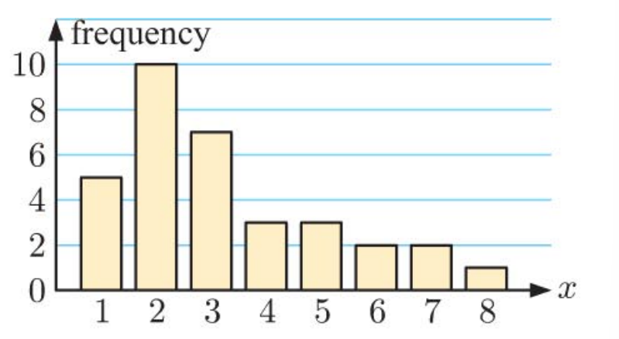
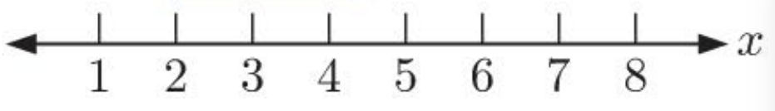
EX 1'
Positively skewed

Slide 11
G. Outliers

Slide 12
Outliers: extraordinary data that are separated from the main body of the data
but...
how to identify if they are separated from the "main body" or not?

Slide 13
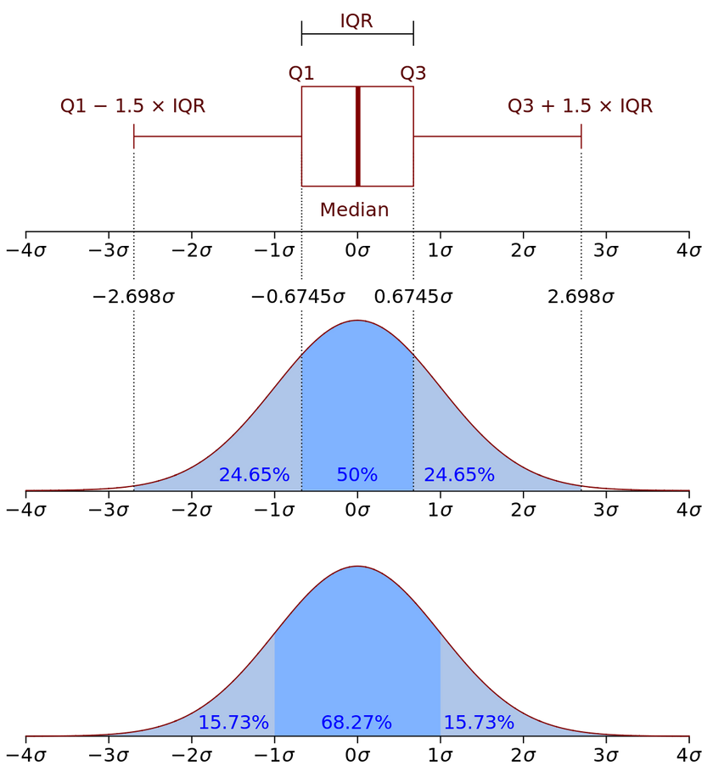
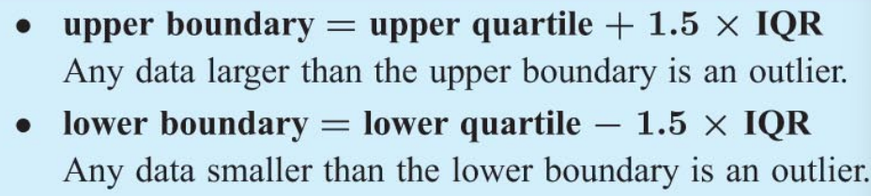
A commonly used test to identify outliers
involves the calculation of upper and lower boundaries:

Slide 14
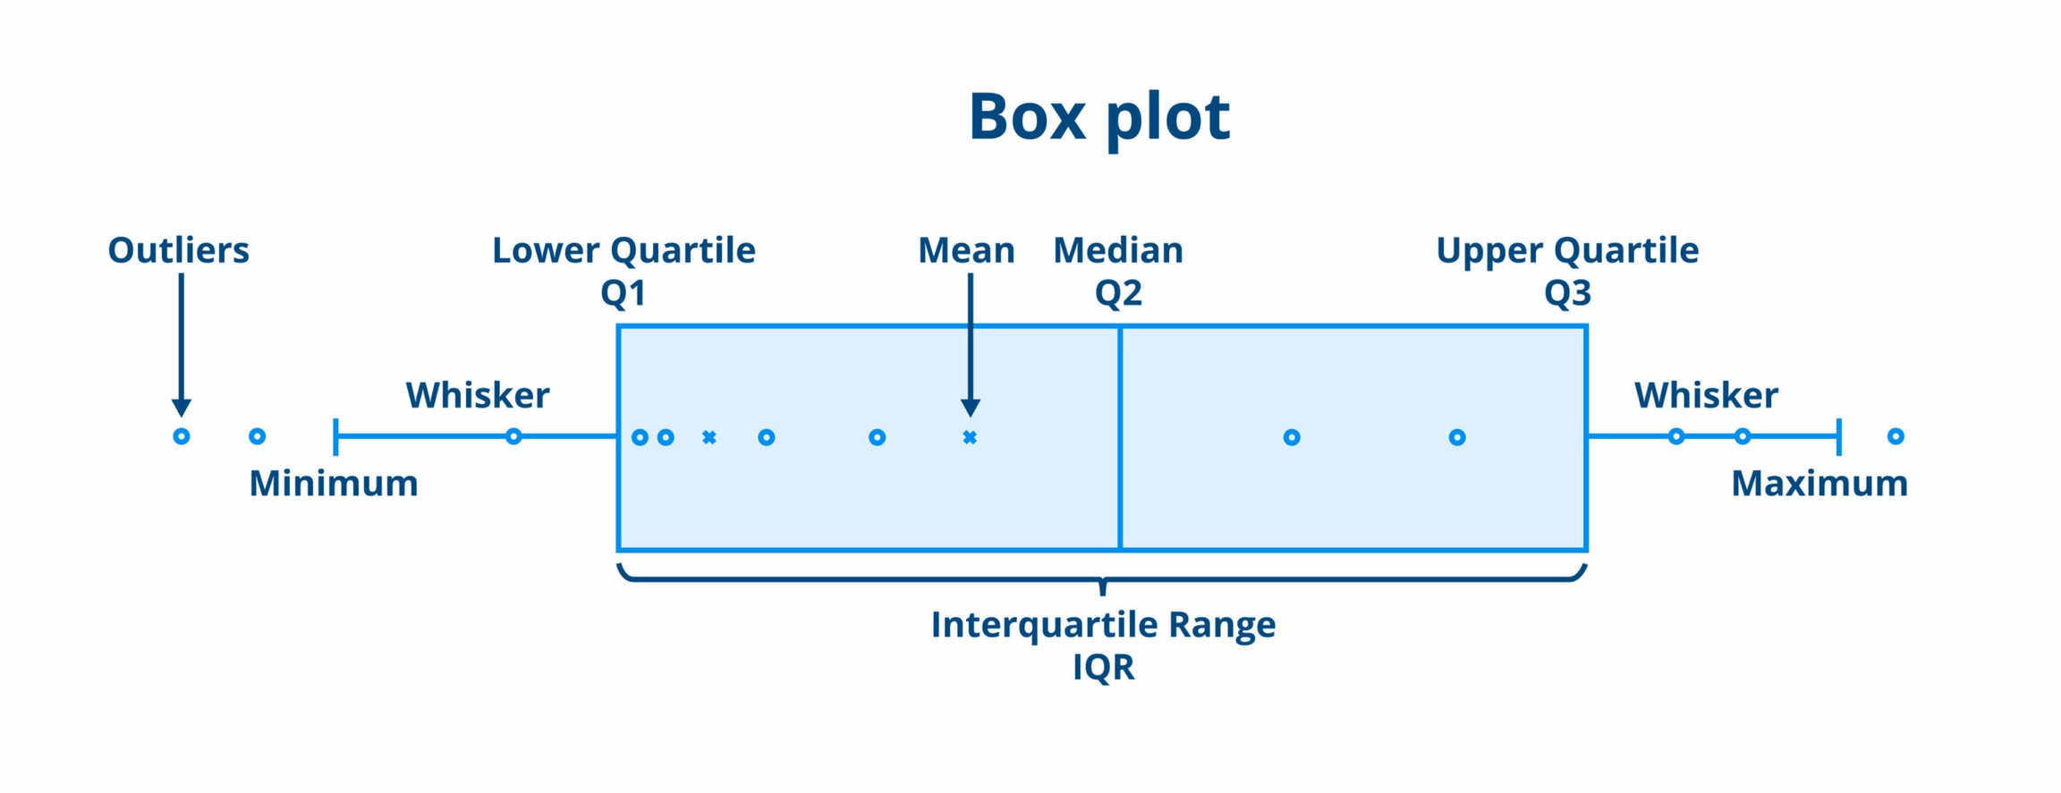

Slide 15
ATTENTION:
The minimum and maximum value used to draw the whisker is determined after outliers are eliminated.

Slide 16
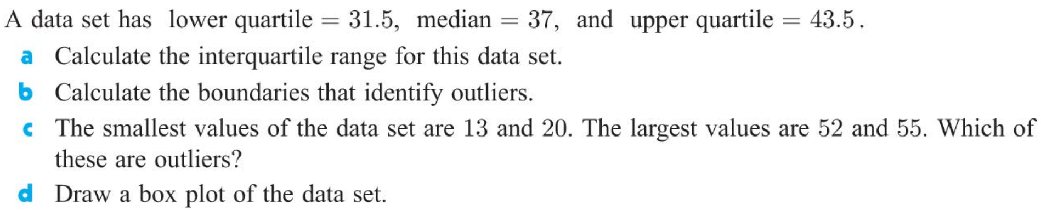
EX 2

Slide 17
Presentation of GDC using
Notes:
切换gdc操作软件，演示by吵一架

Slide 18
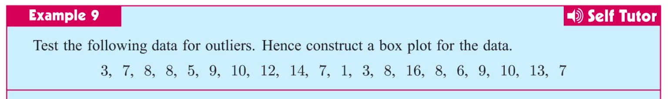
EX

Slide 19
Review
What is box and whisker diagram and outliers?
How to draw the diagram
How to use GDC?

Slide 20

Reference
·Haese Math AAHL textbook
·Interquartile range - Wikipedia
·Box plot - Wikipedia
·Quartile - Wikipedia

